Slide 1

SDV602 Milestone 3
Video Presentation
Achuthanand Vasudevan

Slide 2

UNITY – Game Development Env
Cross platform game engine
Pros
Cross platform development
Effective for 2D rendering
Great asset store
Easy to use interface
Less expensive
Large availability of tutorials
Scripting in Unit
Way to communicate with Game Objects
It tell game objects
How to behave
How to interact
Important features
All in one editor
2D & 3D
AI pathfinding tools
Efficient workflows
User interfaces
Physics Engine
Custom tools
Parts of a Script – using C#
Variables
Functions
Classes
In-built functionalities
Start
Update
Awake
Cons
Lot of the facilities provided by other engines are still in development stage
High memory consumption
Out of date documentation
Free features of other engines are not available here without paying
Need extra license for pro mobile
Unity Interface
Scene view
Game view
Hierarchy Window
Project window
Inspector window
Toolbar
Button area
Miscellaneous Editor settings
Scripts supported by Unity
C# - best choice
JavaScript - alternative
Boo – Old choice
Iron Python – odd choice
Lua – Interesting choice
C/C++ - For plugins
Rust – For plugins

Slide 3

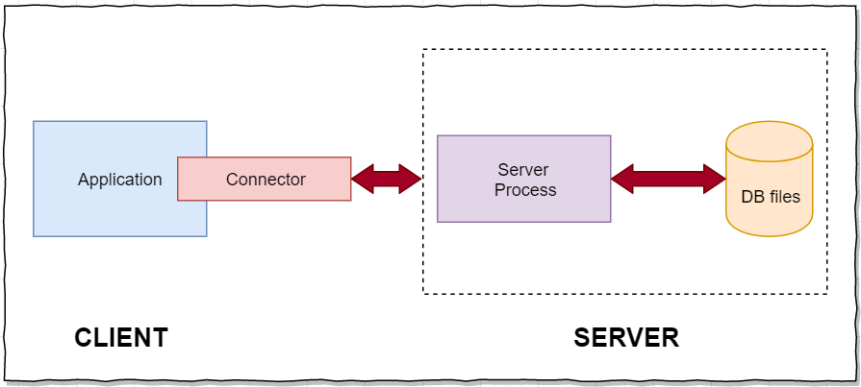
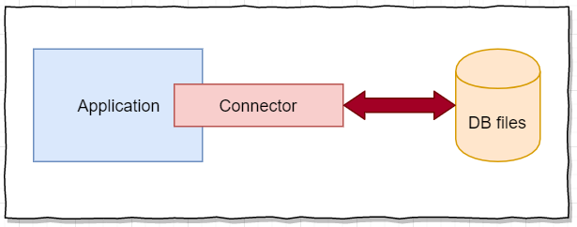
SQLite
SQLite is a library that implements small, fast, self-contained, high-reliability, full-featured Serverless SQL database engine
Serverless SQLite Architecture
RDBMS Client/Server Architecture
Advantages
Light Weight database
Self contained
Requires only minimal support
Support embedded environments
Phones
Game consoles
Zero configuration
Serverless architecture. Hence no config files required
Dynamic data types
No installation required
Compatible with all languages
Portable – supports both 32 and 64 bit
Better performance
Reading and writing is faster
Loads only required data
Dis-Advantages
Will be deleted when app is uninstalled
If file storage on internal memory, which also gets deleted on app uninstall
If file storage on external memory, is open for access by any other applications
It’s slow (no caching mechanism)
In most cases database size restricted to 2GB
Not scalable

Slide 4

Remote Storage – JsnDROP
An online server can be defined as a program or a device that enables other programs or devices to access and provide various facilities. These are not located locally to the program that access it. Hence these severs can be accessed from anywhere with a valid credentials
Generally Remote storage system are those sites or services that enables the users to host, edit, share and sync data files. These files can be in any format.
What is JsnDROP?
Remote storage system
Stores data in relational tables
Allow users to communicate using JSON format
Authenticates the user using token
JsnDROP Commands
CREATE
STORE
ALL
DELETE
DROP
JsnDROP Supporting Keywords
PK
AUTO
WHERE
What is JSON?
Stands for JavaScript Object Notations
Lightweight format for storing & transporting
Often used to sent data to and from server
Self describing and easy to understand
JSON Syntax Rules
Data is in name/value pairs
Separated by comma
Curly braces hold objects
Square bracket hold arrays
Example:
{ “User”: [{
“Name”:”Achu”,“Gender”:”male”},
{“Name”:”Mary”,”Gender”:”female”}
]}

Slide 5

Generics
Generics allows you to define the data type of programming elements in a class or method.
It allows you to define a class or method that can work with any data type.
Placeholders are used for the type of fields, methods, parameters etc.
Placeholders will be replaced with specific type at compile time.
Defined using angle brackets <T>
Compiler assigns the type passed by the caller.
Can be applied to:
Interface
Abstract class
Class
Method
Static method
Property
Event
Delegates
Operator
Example of a Generic Class
class MyGenericClass<T> {
private T genericMemberVariable;
public MyGenericClass(T value) { genericMemberVariable = value;
}
public T genericMethod(T genericParameter) { Console.WriteLine("Parameter type: {0}, value: {1}", typeof(T).ToString(),genericParameter); Console.WriteLine("Return type: {0}, value: {1}", typeof(T).ToString(), genericMemberVariable);
return genericMemberVariable;
}
public T genericProperty { get; set; }
}
Advantages
Increased reusability of code
Type safe.
It removes the possibilities of boxing and unboxing, Hence it has performance advantage
Limitation
Enumerations cannot have generic type parameters
Light weight dynamic methods cannot be generic
A nested type that is enclosed in a generic type cannot be instantiated unless types have been assigned to all enclosing types parameters

Slide 6
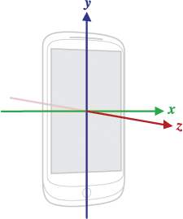
Sensors
A sensor can be defined as a component that detects the changes in the nearby environment and then sends the relevant data to the operating system or processor.
Three main categories
Motion Sensors
Measures axis-based motions
Acceleration forces
Rotational forces
Includes
Accelerometer
Gravity Sensors
Gyroscopes sensors
Environment Sensors
Measures environmental parameters
Air pressure
Temperature etc.
Position Sensors
Measures physical position of device
Includes
Orientation sensors
Magnetometers
Standard sensors on mobile
Accelerometer
Ambient Light Sensor
Ambient Temperature Sensor
Air Humidity Sensor
Barometer Sensor
Fingerprint Sensor
Gyroscope Sensor
Harmful Radiation Sensor
Magnetometer
NFC sensor
Proximity Sensor
Pedometer Sensor
Sensor & Hardware Used in Game App
Accelerometer
To measure the reading of tilt actions and thus to predict the answer
Used to play level 2
Device Front Camera
Used to take profile picture while new user registers.
Unity Native Classes
Accelerometer
Input class
Input.acceleration.x
Input.acceleration.y
Device Front Camera
WebCamTexture class
WebCamTexture.devices
WebCamTextureObj.Play()

Slide 7
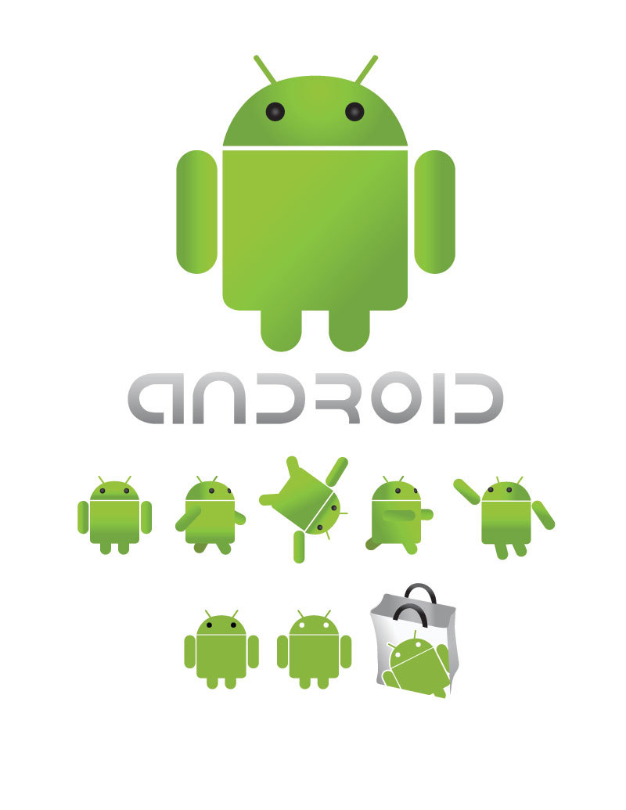
Building To Android Platform
Supports building games for more than 25 different platforms including
Mobile
Desktop
Consoles
Virtual Reality
Build to Android
Configure settings
Player settings allows to configure runtime settings
Build settings allow to configure parameters and build
Build Settings
Can access – File -> Build settings
Select Android under platform
Click Switch Platform to make the selection default
Click Build to create the build
To create and run you build click Build and Run
Available settings
Texture compression
ETC2 fallback
Build System
Export Project
Build AppBundle for Google Play
Run device
Development build
Autoconnect profiler
Script Debugging
Scripts only Build
Compression method
SDKs for App Stores
Environment Setup
Install Android Build support and Android SDK & NDK tools
Enable USB debugging on mobile device
Unity Remote
Designed to help Android, iOS and tvOS development
The app connects with unity while running in play mode from unity editor
Game view is duplicated in device screen but with reduced framerate
Following Input data will be streamed back to the editor
Touch and stylus input
Accelerometer
Gyroscope
Device camera streams
Compass
GPS

Slide 8

Bibliography
Advantages and Limitations of Generics. (2013, November 24). Retrieved from Microsoft: https://docs.microsoft.com/en-us/previous-versions/ms172194(v=vs.110)?redirectedfrom=MSDN
Android. (2019, November 13). Retrieved from Unity Documentation: https://docs.unity3d.com/Manual/android.html
C# - Generics. (2019, November). Retrieved from TutorialsPoint: https://www.tutorialspoint.com/csharp/csharp_generics.htm
Generics in C#. (2019, November). Retrieved from TutorialsTeacher: https://www.tutorialsteacher.com/csharp/csharp-generics
SQLite. (2019, October). Retrieved from SQLite Documentation: www.sqlite.org/index.html
SQLite Documentation. (2019, October). Retrieved from SQLite: www.sqlite.org/index.html
SQLite Tutorial. (2019, October). Retrieved from What is SQlite: https://www.sqlitetutorial.net/what-is-sqlite/
Unity (game engine). (2019, November 15). Retrieved from Wikipedia: https://en.wikipedia.org/wiki/Unity_(game_engine)#Supported_platforms

Slide 9


